Slide 1
Final Presentation- College Expansion
Junyan Yao
May 8th, 2017

Slide 2
Outline
Recap of midterm
Data Analysis
Next Step

Slide 3
Recap
Project Question:
Predict whether to open a new college or not in one area;
Who cares?
The local government agents
What a success will look like?
By using the past data to predict if this area will have a new campus open.

Slide 4
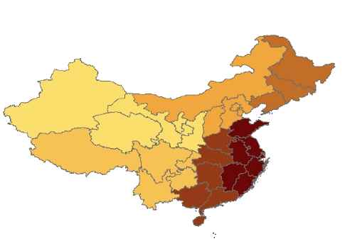
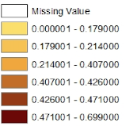
Data
Increases in the number of campuses by region
Panel Data
1985-2011
Across all regions, except HK…
Campus dataset: number of campuses, number of comprehensive campuses, level of campuses…
Economic dataset: GDP per capita, population, Foreign direct investment, worker’s average wage…

Slide 5
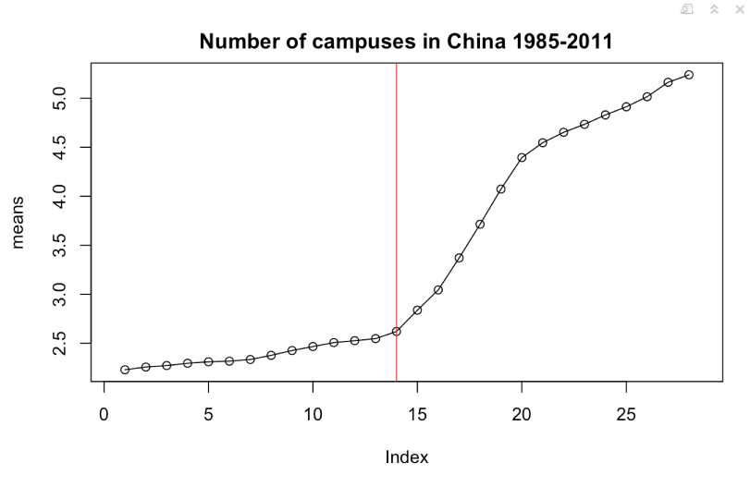
Summary Statistics: Split the data to pre-expansion and expansion
Note: Red line indicates year of 1999.

Slide 6
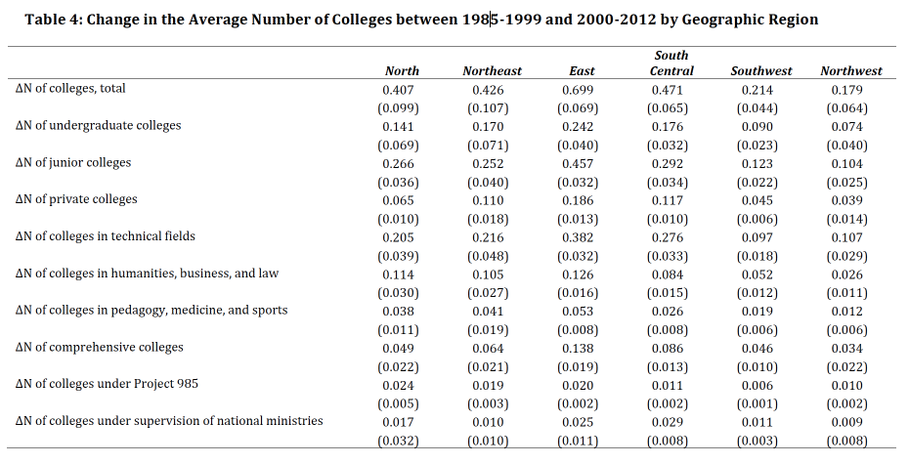
Summary Statistics: by Geographic Region

Slide 7
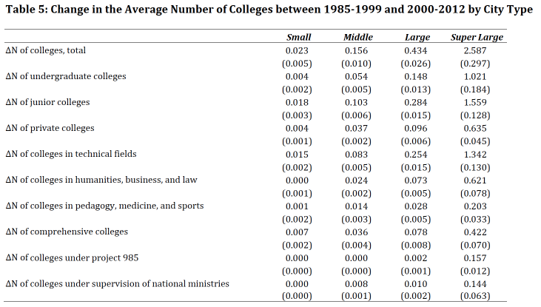
Summary Statistics: By Population Size
Small City: lower than 200,000 persons;
Middle City: 200,000- 500,000 persons;
Large City: 500,000- 10,000,000 persons;
Super large city: over 10,000,000 persons;

Slide 8
Summary Statistics Real GDP Movement by Regions-Prefecture level
#1- North; 2- Northeast; 3- East; 4-South Central; 5- Southwest; 6- Northwest;

Slide 9
Summary Statistics Real GDP Movement by Regions-Urban Core
#1- North; 2- Northeast; 3- East; 4-South Central; 5- Southwest; 6- Northwest;

Slide 10
Model Consideration
Multiple Regression model:
Pros: did not consider any year effect;
Cons: easy to implement it;
Logistics Regression model:
Same with OLS
Multi level regression
Treat year as one predictor
Elastic Net

Slide 11


Elastic Net
Propose the elastic net, a regularization and variable selection method;
Consider the usual linear regression model:
But for Elastic Net:
The lambda term is a hyper parameter and is estimated using cross validation.
Use caret package

Slide 12
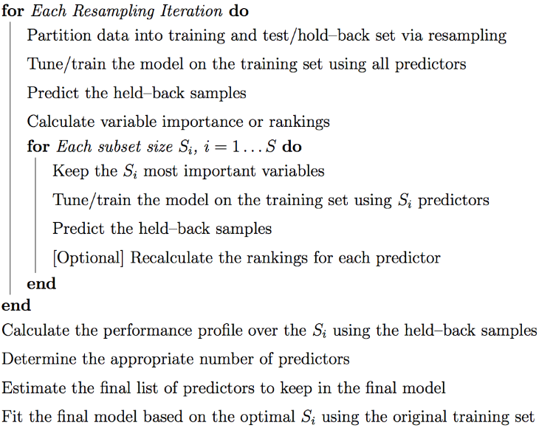
Big Picture of the model fitting
Notes:
Reference: http://citeseerx.ist.psu.edu/viewdoc/download?doi=10.1.1.168.1655&rep=rep1&type=pdf

Slide 13
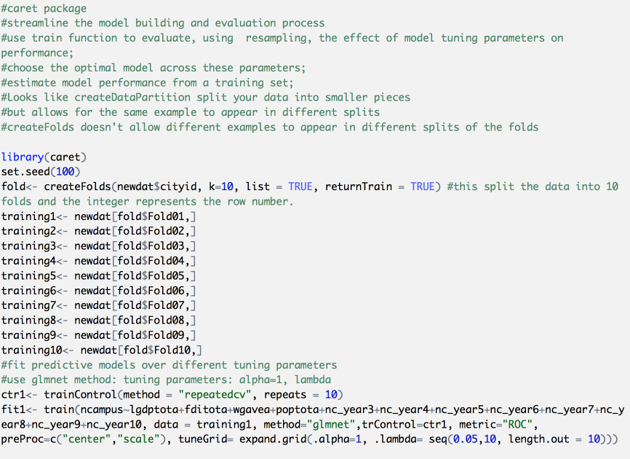

Slide 14
Next Step
R implementation of Elastic Net model, but I am stuck with training the model on training sets with all predictors. The problems is the missing values in my dataset. I will need to do some imputation in missing data(that’s one option to deal with missing data). This is not the model fitting problems. This is data pre-processing problems.

Slide 15

Comments/Questions?

